Slide 1




TRADE
Version 1.0

Slide 2

IEMI
Home Page
Explore Index
State Profile
Compare States
Tool and Analysis
Downloads
About the Index
Notes:
The primary data management contains three steps – Ingestion, Cleaning and Calculate. Let us understand about each step.

Slide 3


LANDING PAGE
Click on 'Explore' to land on the IEMI Home Page.

Slide 4
LANDING PAGE
Click ‘IEMI icon' to land on the IEMI homepage.

Slide 5

1
Home Page

Slide 6
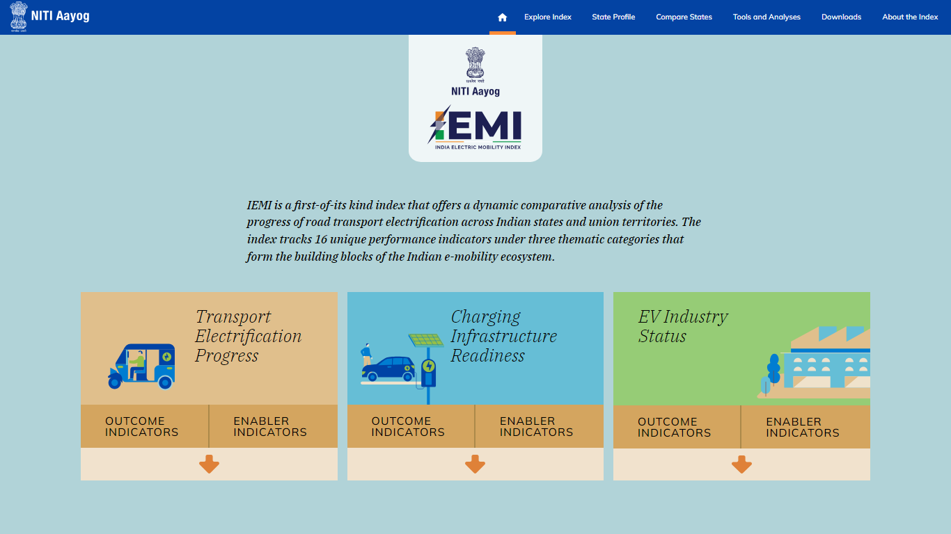
HOME PAGE
Introduction to IEMI and Its Three Themes.

Slide 7
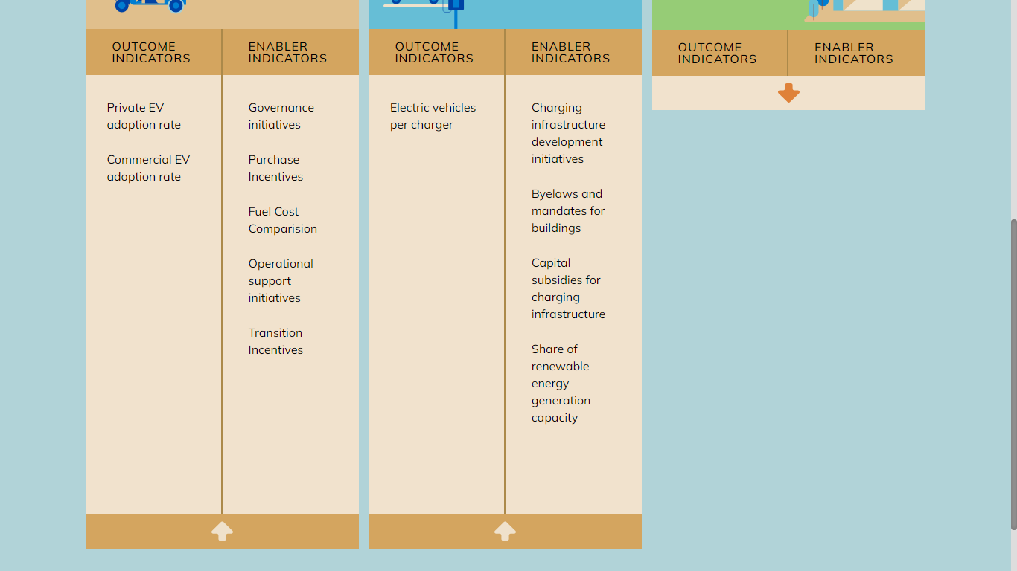
HOME PAGE
Click the downward arrow icon to view ‘Outcome and Enabler indicators’ for selected themes.

Slide 8
2
Explore Index

Slide 9
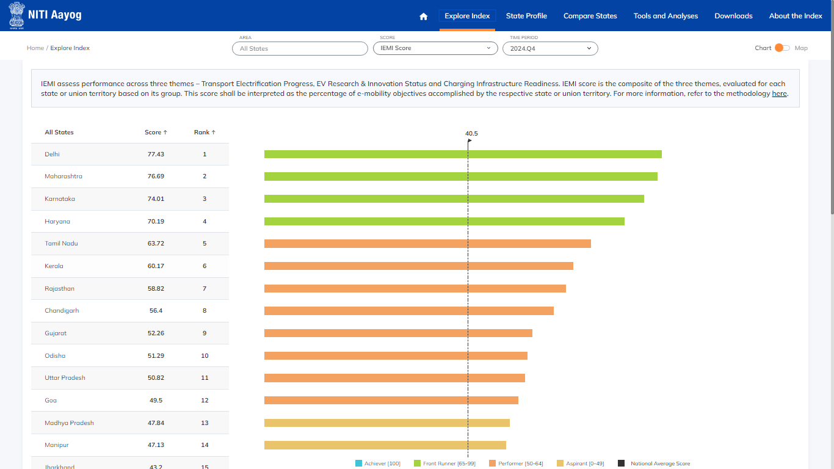
EXPLORE INDEX CHART
Select the 'Explore Index' module to view the scores and ranks of all Indian states based on IEMI and its themes within the selected time period.

Slide 10
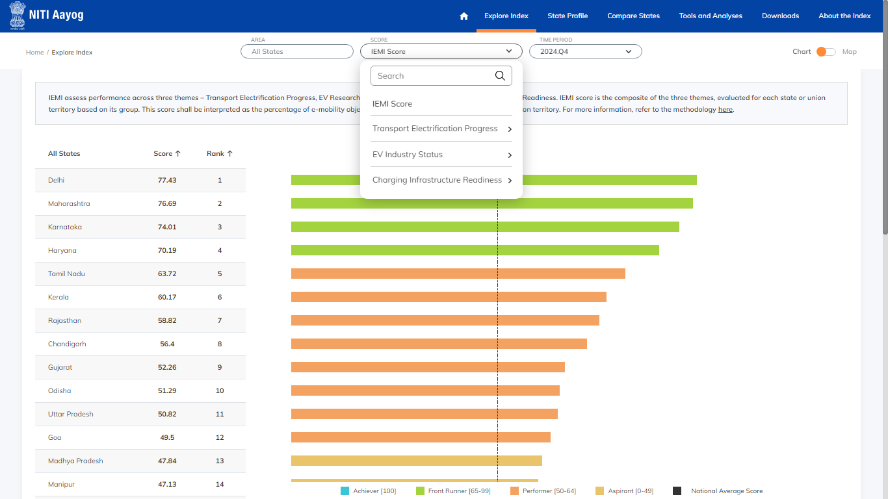
EXPLORE INDEX CHART
Select the Score criteria to display Ranks and Scores as per Criteria

Slide 11
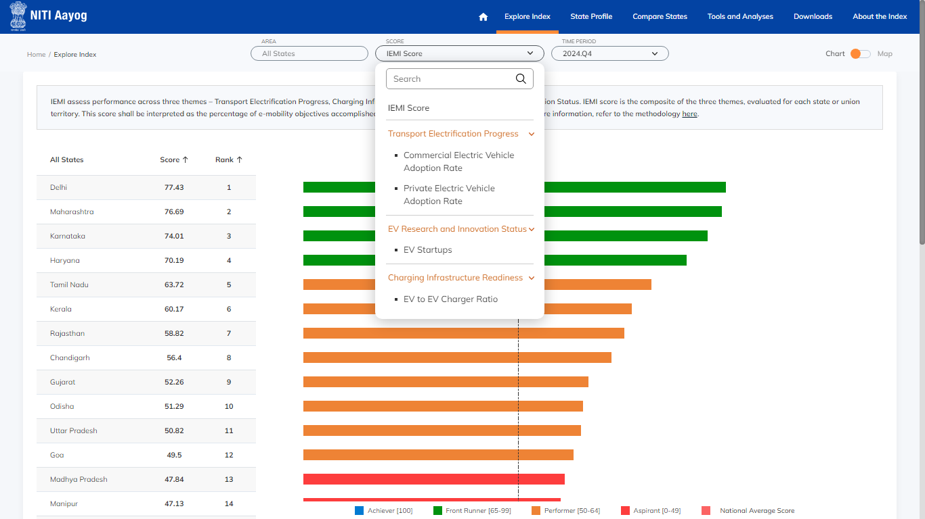
EXPLORE INDEX CHART
Themes contain subgroups for selection. Choose the criteria and view the score chart for the ‘All States’ group.

Slide 12
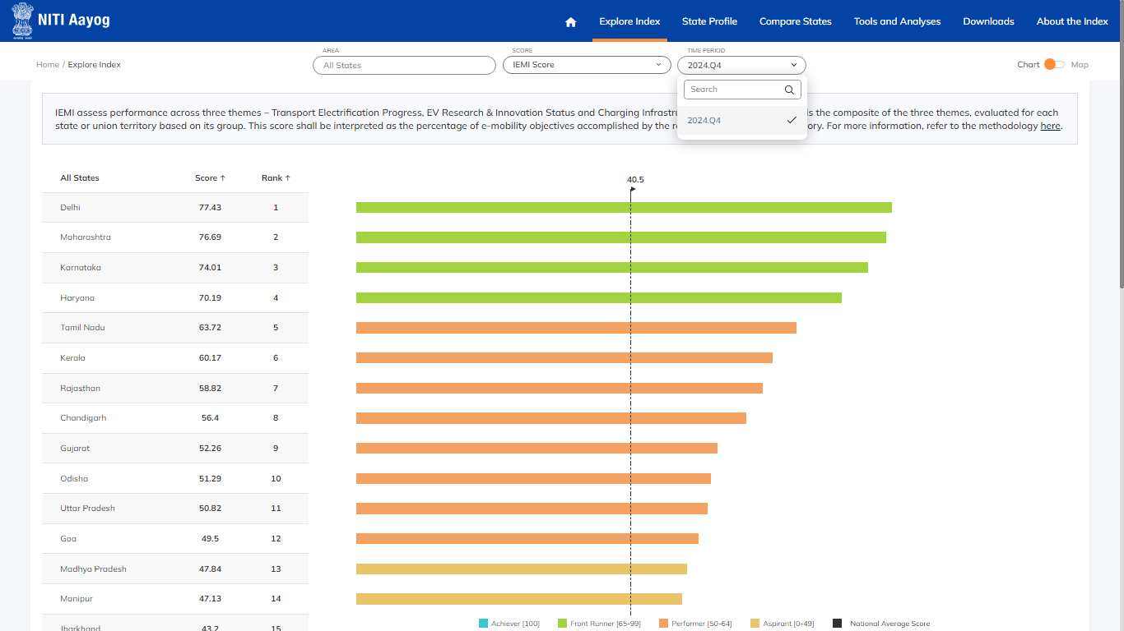
EXPLORE INDEX CHART
Select the available timeline

Slide 13
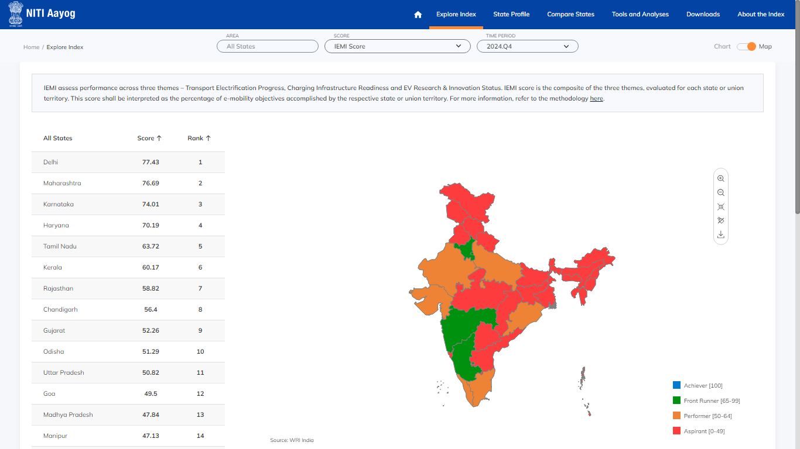
EXPLORE INDEX MAP
Click the toggle button to switch between the chart and the map. View the map and list of scores by states within a specific period.

Slide 14

EXPLORE INDEX MAP
Hover over the map of India to view each state’s specific rank and score.

Slide 15
EXPLORE INDEX MAP
Adjust the map size, reset the map, add labels, or download the map using the toolbar.

Slide 16
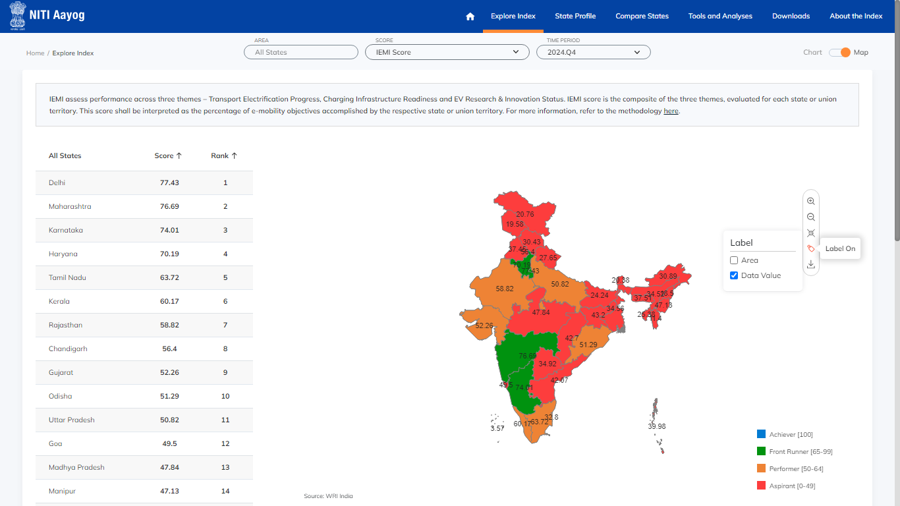
EXPLORE INDEX MAP
Add Data value Label, Area Label or both

Slide 17
3
State Profile

Slide 18
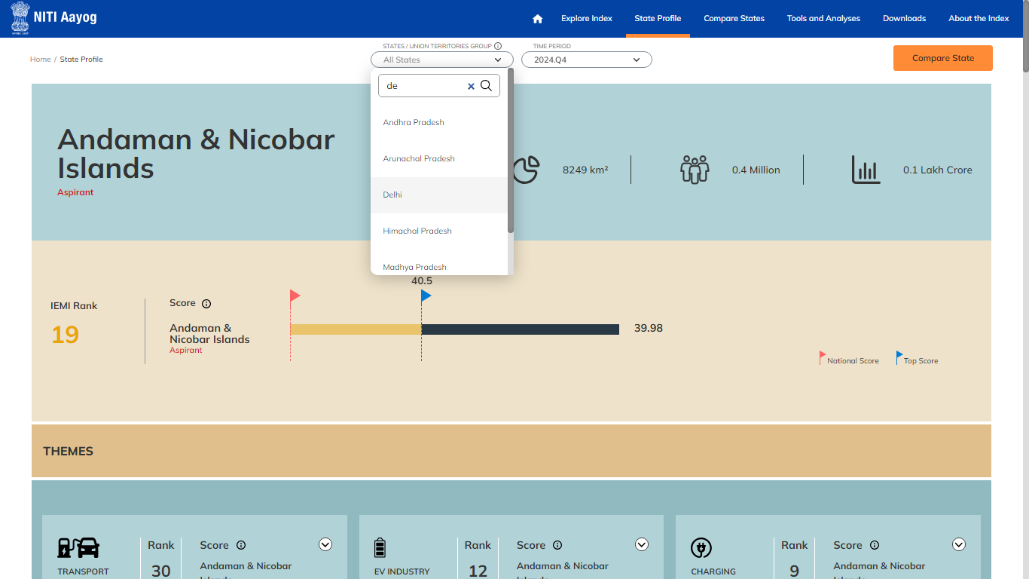
STATE PROFILE
Select a state and period from the dropdown to view the state-wise profile data of themes, outcome indicators, and enabler indicators.

Slide 19
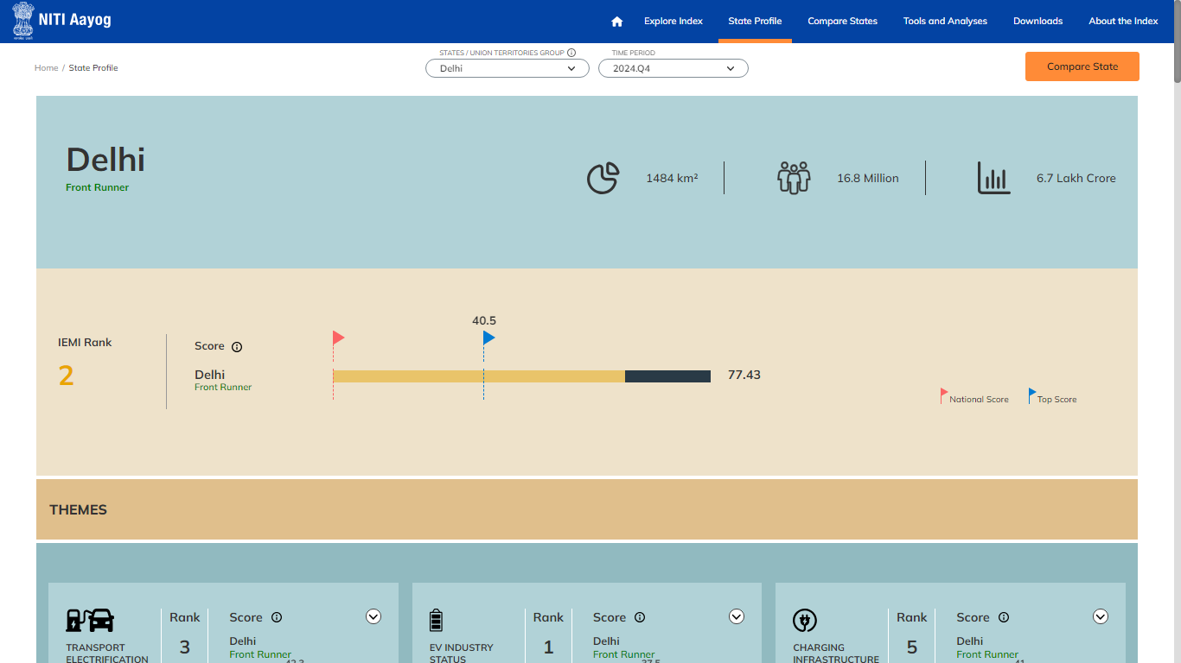
STATE PROFILE
This is the State Profile of Delhi for the year 2024

Slide 20
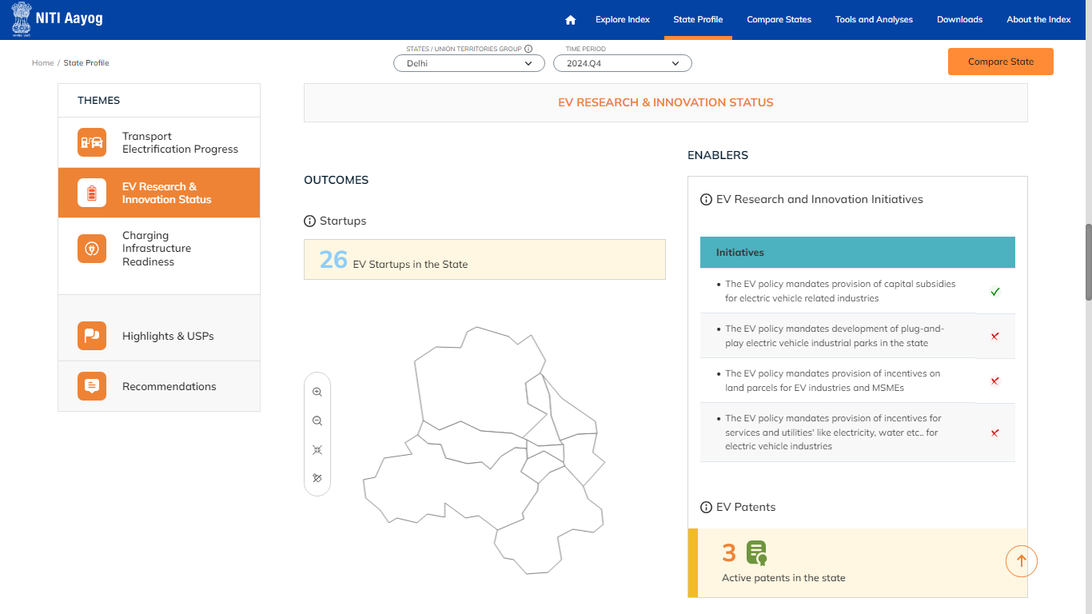
STATE PROFILE
Scroll down to view state-wise theme data of IEMI for outcome indicators and enablers.

Slide 21
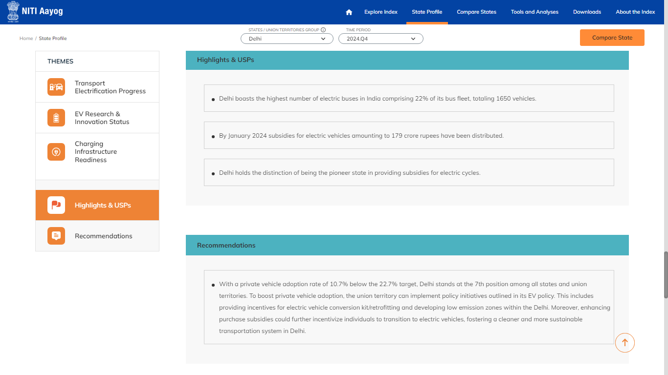
STATE PROFILE
Select ‘Highlights & USP’, and ‘Recommendations’ from the navigation to view it for the selected state.

Slide 22
STATE PROFILE
Click on the "Compare States" button to compare the current selected state's data with two or more states. This will also directs to the ‘Compare States’ Module

Slide 23
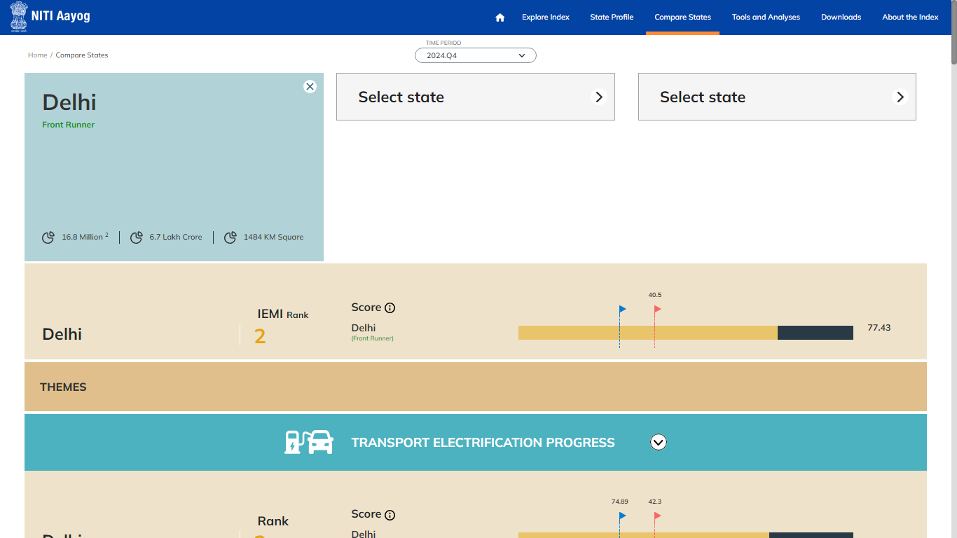
STATE PROFILE
By default, the selected state is displayed as a selection. Add more states to compare by clicking "Select State".

Slide 24
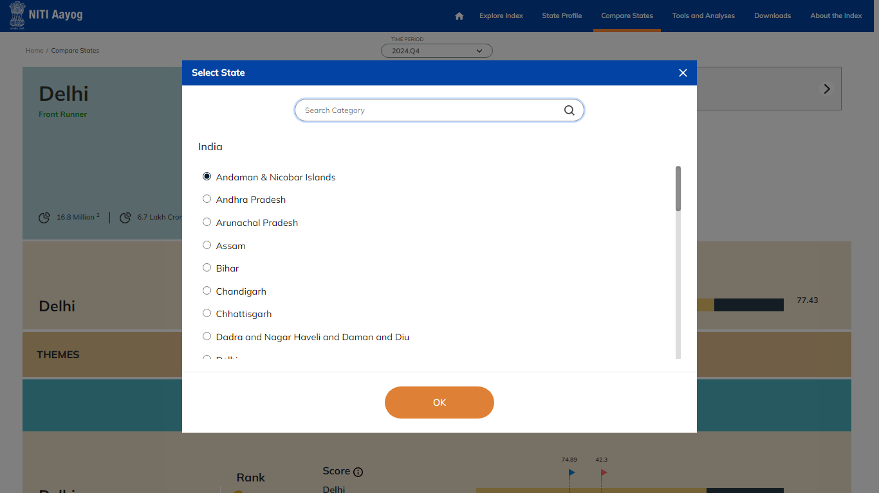
STATE PROFILE
After clicking "Select State“, choose the state for comparison.

Slide 25
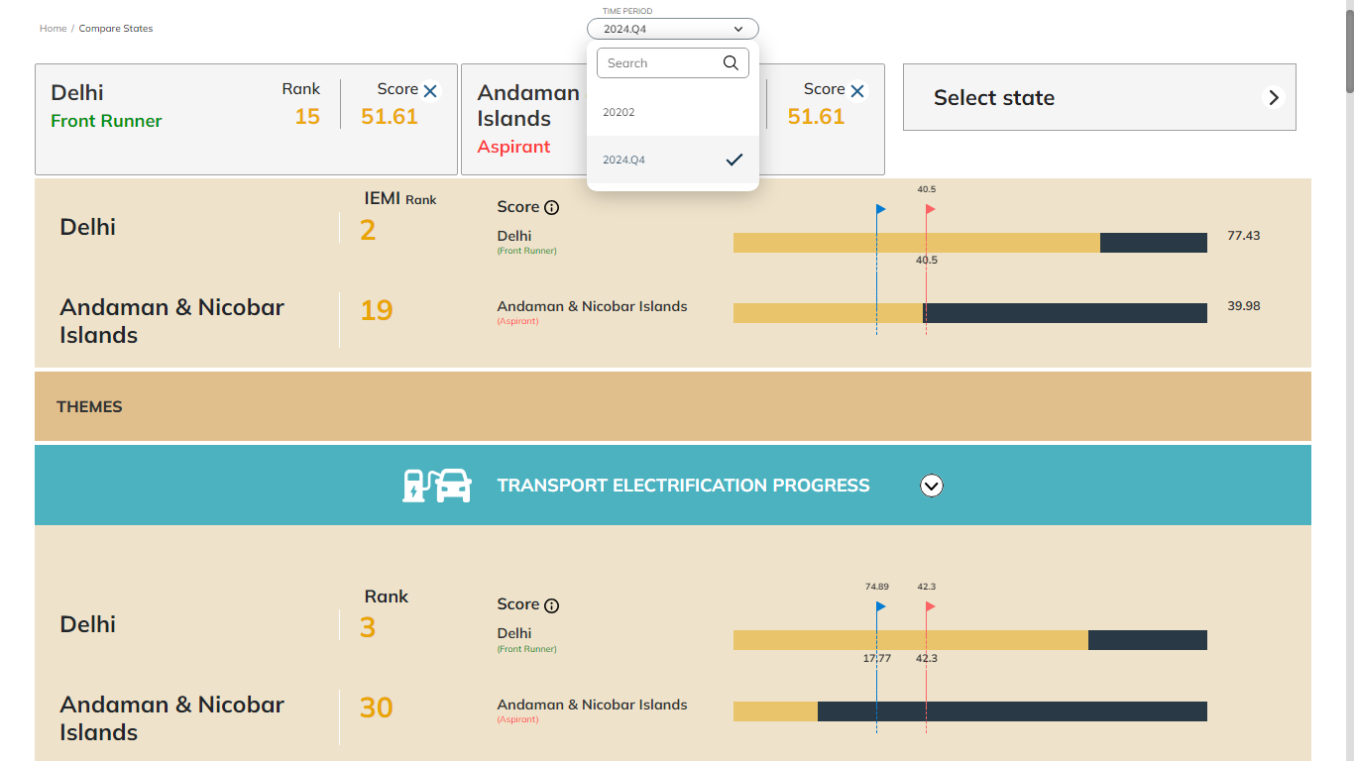
STATE PROFILE
Select the ‘Time Period’

Slide 26
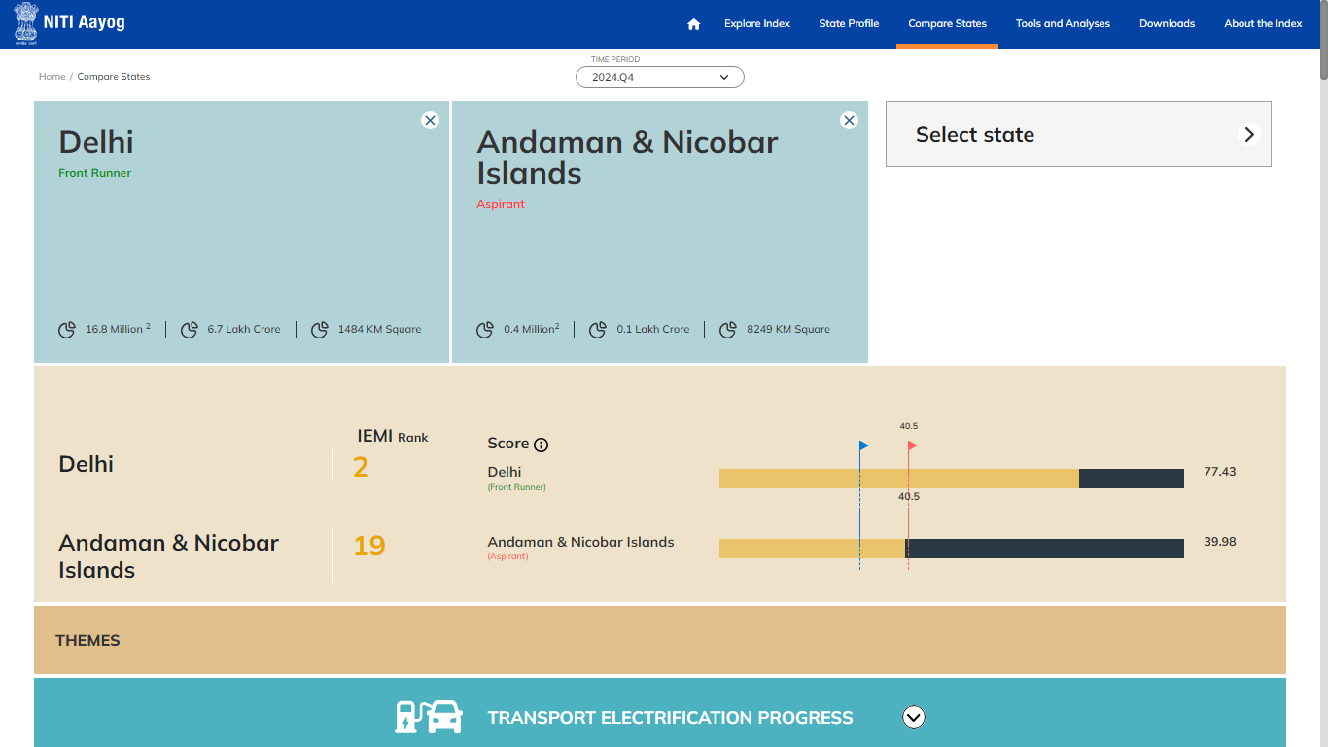
STATE PROFILE
Scroll to compare the data regarding IEMI rank, scores and IEMI themes.

Slide 27
4
Compare States

Slide 28
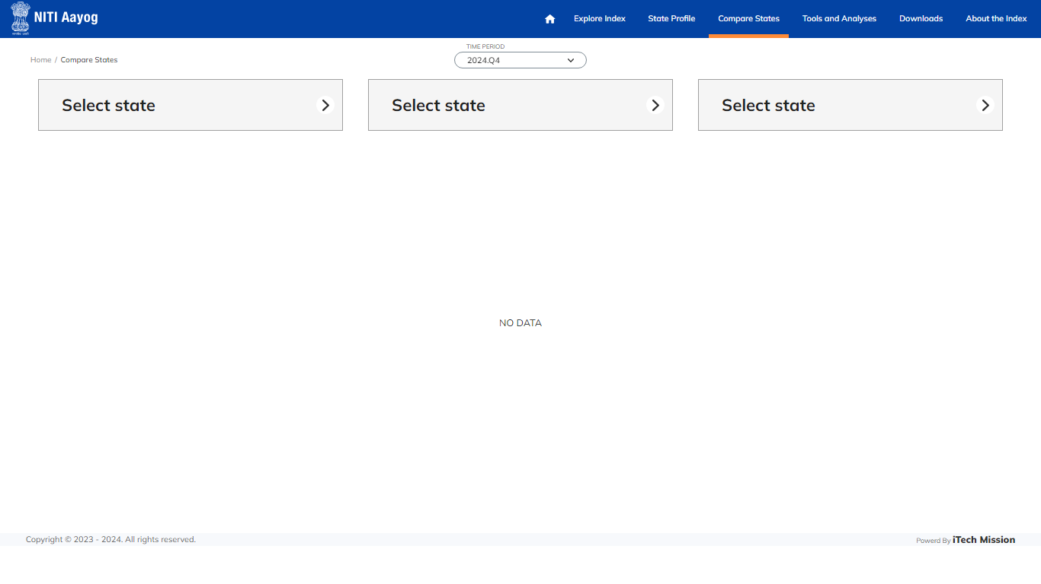
COMPARE STATES
Select the Compare State module to compare the IEMI Profile of two or three states simultaneously.

Slide 29
COMPARE STATES
After clicking "Select State“, choose the state for comparison.

Slide 30
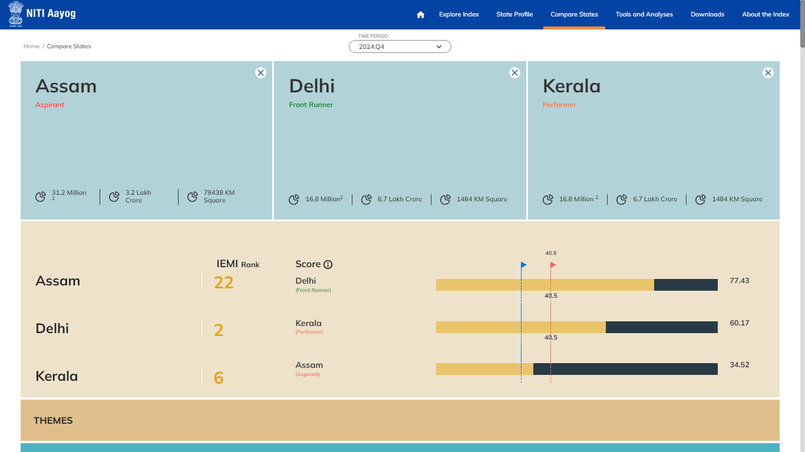
COMPARE STATES
Compare the selected State Profiles

Slide 31
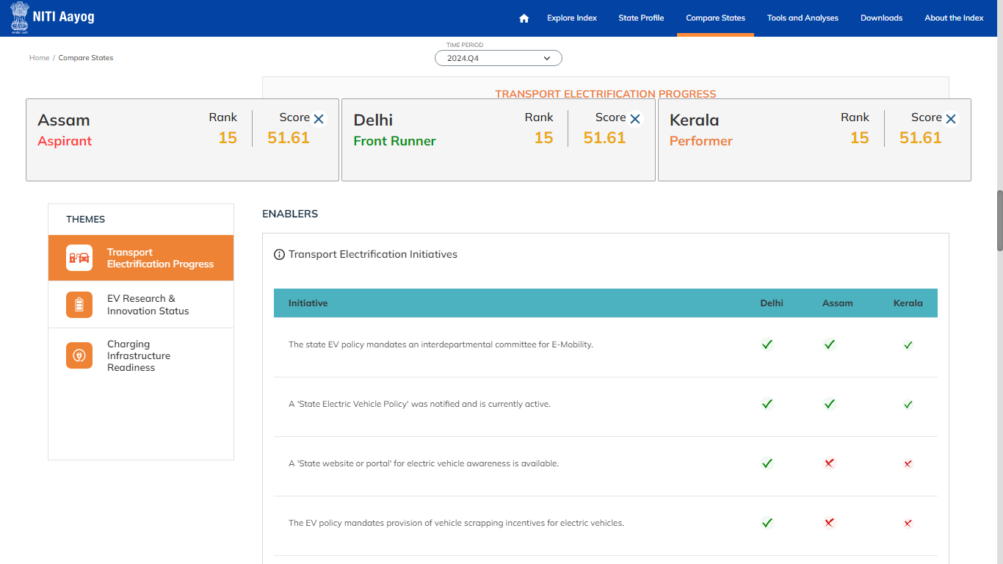
COMPARE STATES
Scroll down to view IEMI Theme based comparisons

Slide 32
5
Tool and Analysis

Slide 33
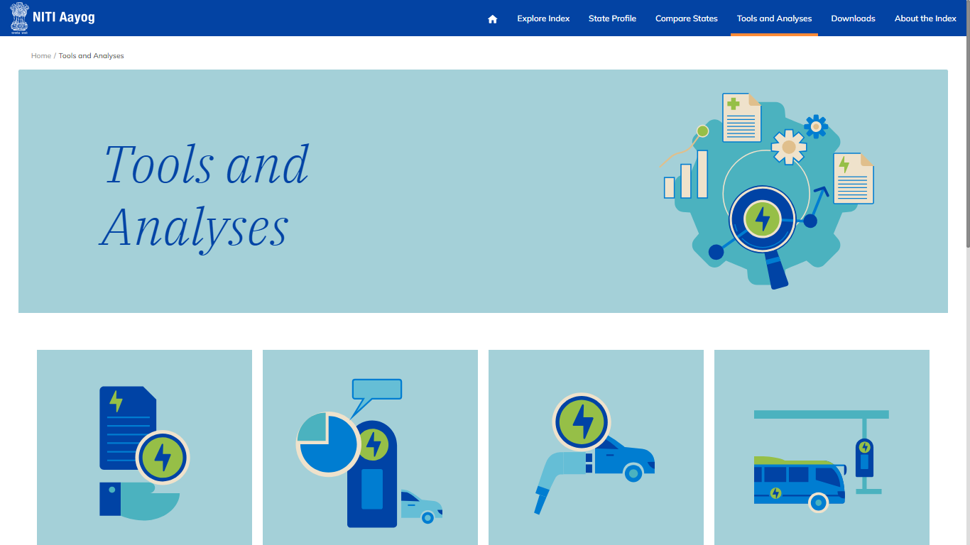
TOOL AND ANALYSIS
From the navigation bar, select Tools and Analyses, and choose Tools for analyses within this module.

Slide 34
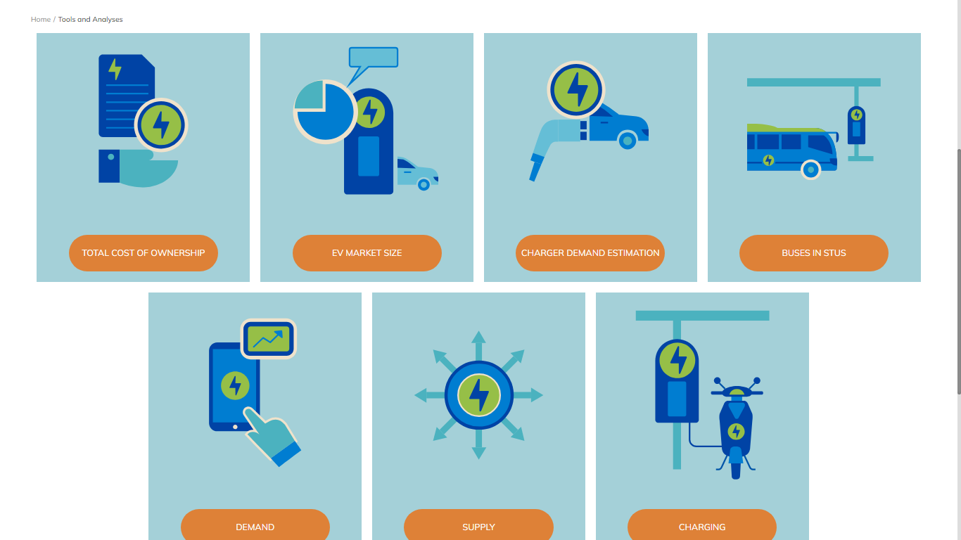
TOOL AND ANALYSIS
Select the tool to view the description for calculation.

Slide 35
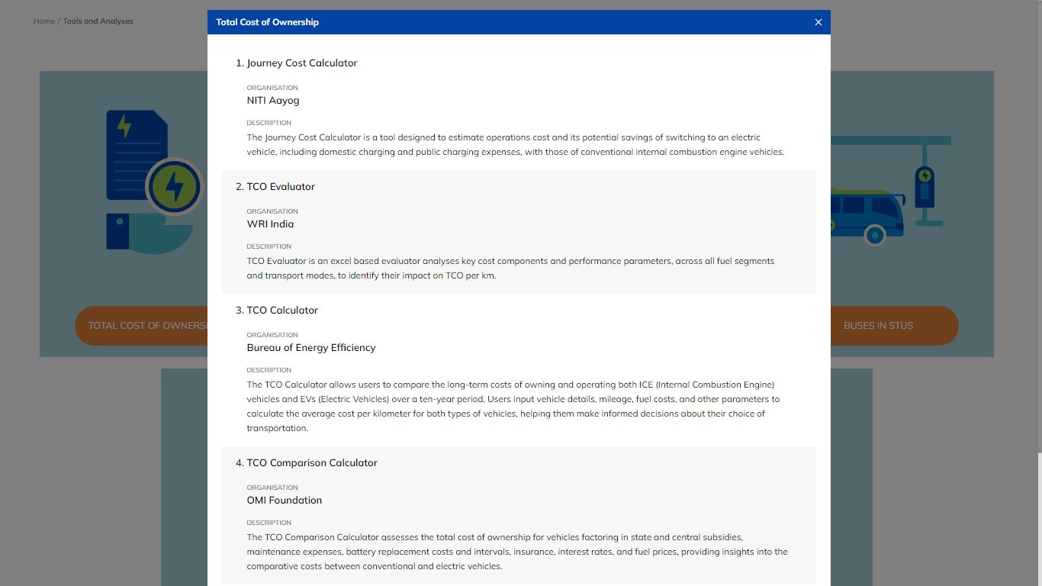
TOOL AND ANALYSIS
On selecting Total Cost of Ownership, learn the methods to calculate it.

Slide 36
6
Downloads

Slide 37
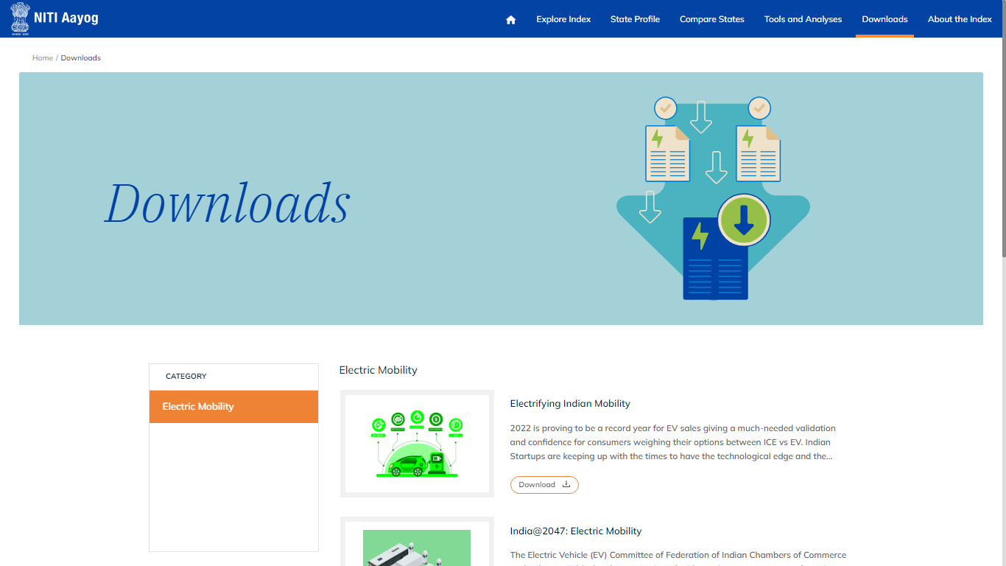
DOWNLOADS
Select ‘Downloads’ module from the navigation bar

Slide 38
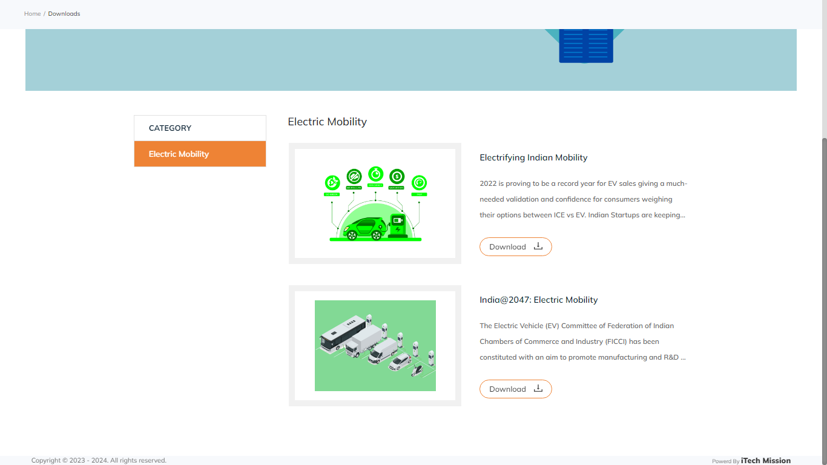
DOWNLOADS
Select Category and Click ‘download’ to download the related documents.

Slide 39
7
About the Index

Slide 40
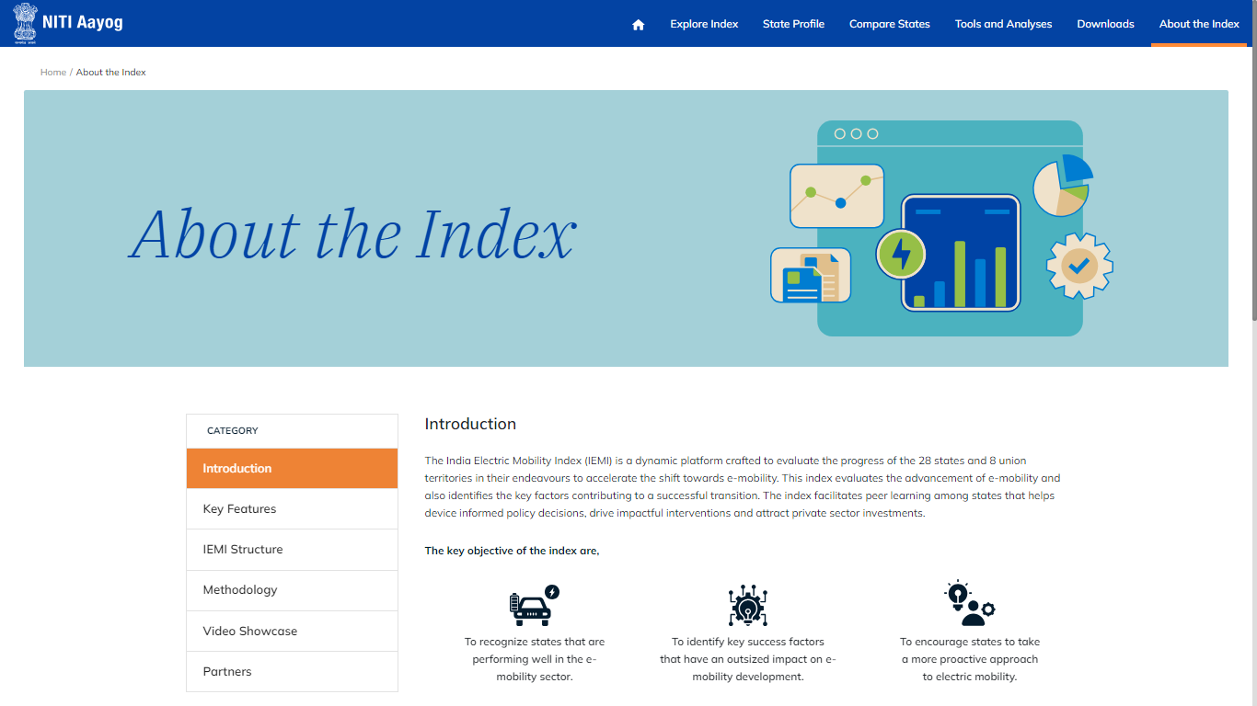
TRANSACTION
Select the ‘About the Index’ module from the Navigation bar.

Slide 41
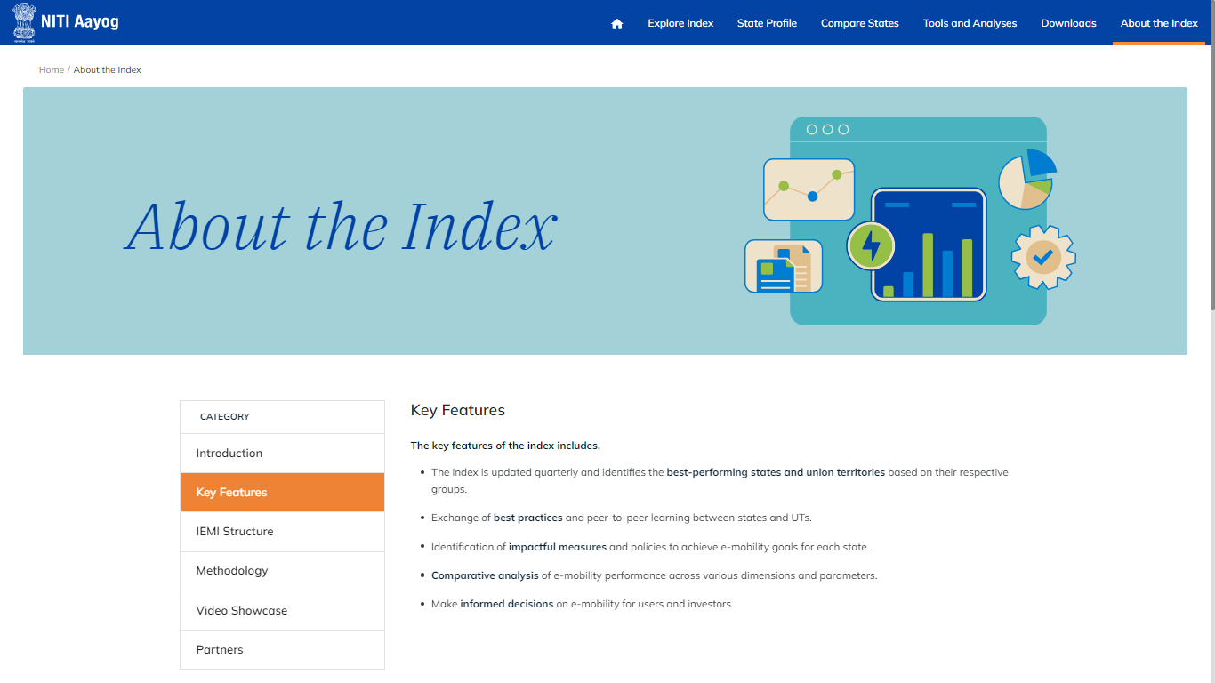
ABOUT THE INDEX
Select a category to view its description.

Slide 42
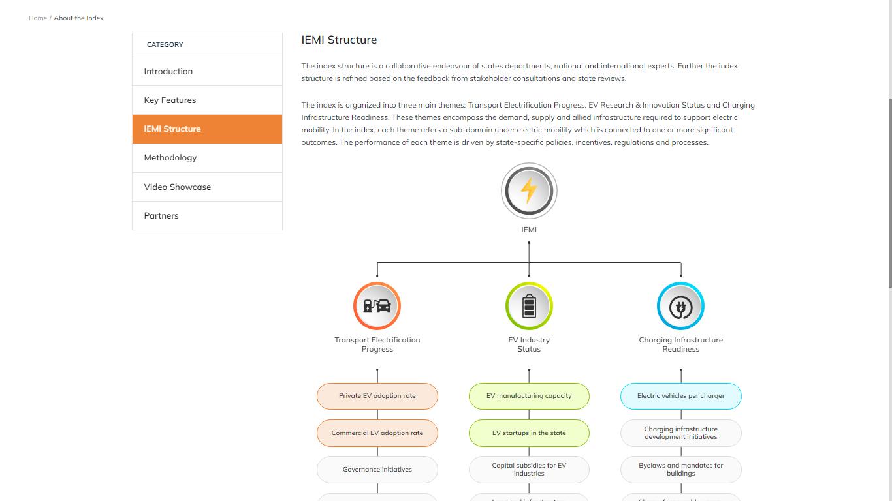
ABOUT THE INDEX
On Selecting IEMI structure, view description about IEMI.

Slide 43


